Slide 1
Class
Weiwei Xu

Slide 2
Point
typedef struct point { float x;
float y;
} Point;

Slide 3
Point
typedef struct point { float x;
float y;
} Point;
Point a;
a.x = 1;a.y = 2;

Slide 4
Point
typedef struct point { float x;
float y;
} Point;
Point a;
a.x = 1;a.y = 2;
void print(const
Point* p){
printf(“%d
%d\n”,p->x,p->y);
}

Slide 5
Point
typedef struct point { float x;
float y;
} Point;
Point a;
a.x = 1;a.y = 2;
void print(const
Point* p){
printf(“%d
%d\n”,p->x,p->y);
}
print(&a);

Slide 6
move (dx,dy)?

Slide 7
move (dx,dy)?
void move(Point* p->x += dx; p->y += dy;
}
p,int dx, int dy) {

Slide 8
Prototypes
typedef struct point { float x;
float y;
} Point;
void print(const void move(Point*
Point* p)j
p,int dx, int dy)j

Slide 9
Usage
Point a; Point b;
a.x = b.x = 1; a.y = b.y = 1; move(&a,2,2);
print(&a); print(&b);

Slide 10
C++ version
class Point { public:
void init(int void move(int
x,int y);
dx,int dy);
void print() const;
private:
int x; int y;
} ;

Slide 11
implementations
void Point::init(int x = ix; y = iy;
}
void Point::move(int x+= dx; y+= dy;
}
void Point::print()
ix, int iy) {
dx,int dy) {
const {
cout << x << ' ' << y << endl;
}

Slide 12
:: resolver
•
<Class Name>::<function name>
•
::<function name>
void S::f() {
::f(); // Would be recursive
::a++; // Select the global a a--; // The a at class scope
}
otherwise!

Slide 13
C vs. C++
typedef
struct
point {
class Point { public:
float x; float y;
} Point;
void void void
init(int print() move(int
x,int y);
const; dx,int dy);
void print(const void move(Point* int
Point* p); p,int
dx, private:
int x; int y;
dy);
Point
a.x =
a;
1; a.y = 2;
} ;
Point a; a.init(1,2);
a.move(2,2);
a.print();
move(&a,2,2); print(&a);

Slide 14


Objects = Attributes + Services
•
Data: the properties or status
•
Operations: the functions
Data
Operations

Slide 15
Stash

Slide 16
Container
•
Container is an object that holds other objects.
•
For most kinds of containers, the common interface is put() and get().
•
Stash is a container that stores objects and can be expanded during running.

Slide 17
Stash
p

Slide 18
Stash
p
add(p)

Slide 19
Stash
p
add(p)

Slide 20
Stash
p
add(p)

Slide 21
Stash
p
add(p)
Each element in Stash is a clone of the object.

Slide 22
Stash
•
•
Typeless container.
Stores objects of the same type.
–
–
Initialized w/ the size of the type Doesn’t care the type but the size
•
•
add() and fetch() Expanded when needed
•
See: Stash2.h, Stash2.cpp, Stash2Test.cpp

Slide 23
Functions in struct
struct Stash {
int size; // Size of each space
int quantity; // Number of storage spaces int next; // Next empty space
// Dynamically allocated array unsigned char* storage;
// Functions!
void initialize(int size); void cleanup();
int add(const void* element); void* fetch(int index);
int count();
void inflate(int increase);
of bytes:
};
See: Stash2.h

Slide 24
Implementation of the functions
•
We just defined in the header file that there will be these functions in this struct.
•
All the bodies of these functions will be in a source file.
See: Stash2.cpp

Slide 25
Call the functions in a struct
Stash a; a.initialize(10);
•
There is a relationship with the function be called and the variable to call it.
•
The function itself knows it is doing something w/ the variable.
•
Example: Stash2Test.cpp

Slide 26
this: the hidden parameter
•
this is a hidden parameter for all member functions, with the type of the struct
void Stash::initialize(int sz)
➔ (can be regarded as)
void Stash::initialize(Stash*this, int sz)
•
To call the function, you must specify a variable
Stash a; a.initialize(10);
➔ (can be regarded as)
Stash::initialize(&a,10);

Slide 27
this: the pointer to the variable
•
Inside member functions, you can use this as the pointer to the variable that calls the function.
•
this is a natural local variable of all structs member functions that you can not define, but can use it directly.

Slide 28
Objects
•
In C++, an object is just a variable, and the purest definition is “a region of storage”.
•
The struct variables mentioned before are just objects in C++.

Slide 29
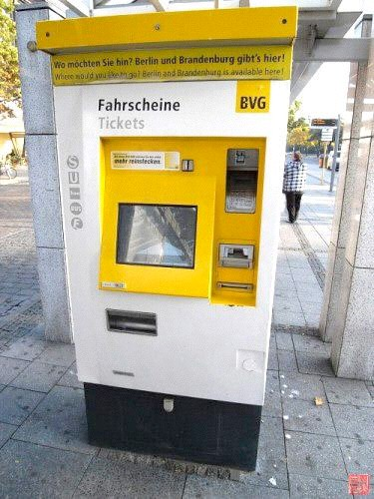
Ticket Machine
Ticket machines print a ticket when a customer inserts the correct money for their fare.
Our ticket machines work by customers' inserting money into them, and then requesting a ticket to be printed. A machine keeps a running total of the amount of money it has collected throughout its operation.

Slide 30
Procedure-Oriented
Step to the machine
Insert money into the machine
The machine prints a ticket
Take the ticket and leave

Slide 31
Procedure-Oriented
Step to the machine
Insert money into the machine
The machine prints a ticket
Take the ticket and leave
We make a program simulate the procedure of buying tickets. It works. But there is no such machine. There's nothing left for the further development.

Slide 32
Something is there

Slide 33


Something is there
PRICE
balance
total

Slide 34











Something is there
PRICE
balance
total
show prompt
print balance
insert money
print ticket

Slide 35



Something is here
TicketMachine PRICE
Balance
Total
showPrompt
getMoney
printTicket
showBalance
printError

Slide 36

Something is here
TicketMachine PRICE
Balance
Total
showPrompt
getMoney
printTicket
showBalance
printError
ticketMachine 1: TicketMachine
price
balance total

Slide 37
Turn it into code
TicketMachine PRICE
Balance
Total
showPrompt
getMoney
printTicket
showBalance
printError
ticketMachine 1: TicketMachine
class TicketMachine {
private:
const int PRICE;
price
balance total
int balance;
int total;
};

Slide 38
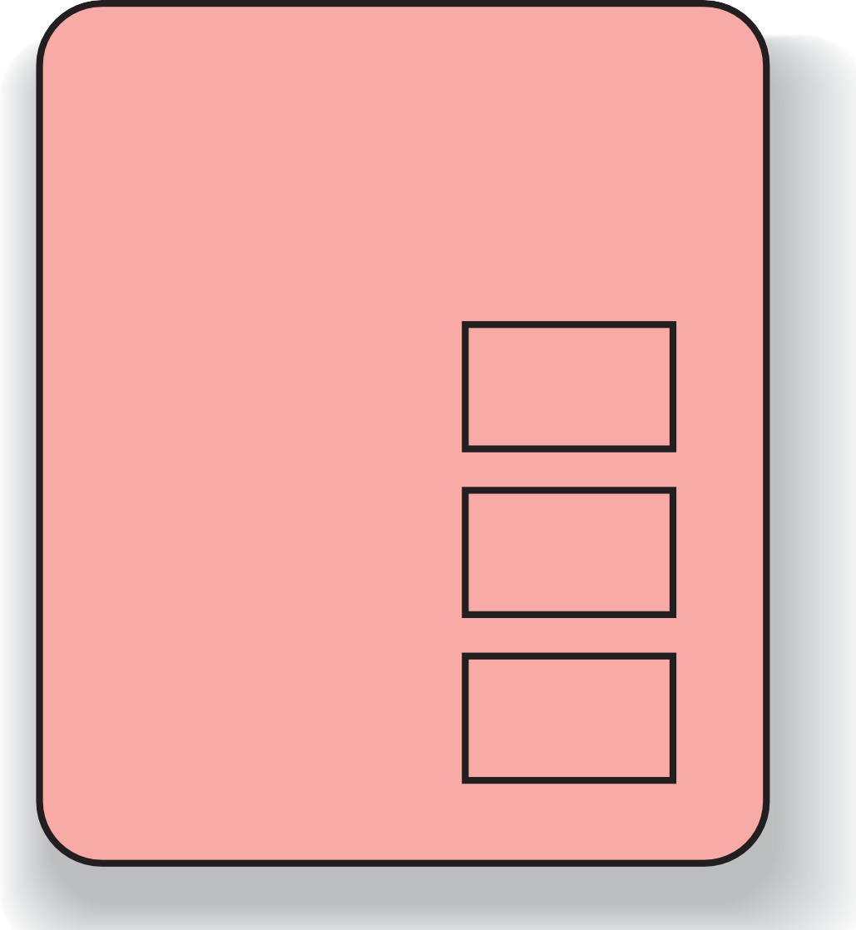
Turn it into code
class TicketMachine { public:
TicketMachine PRICE
Balance
Total
showPrompt
getMoney
printTicket
showBalance
printError
void showPrompt();
void getMoney(); void printTicket(); void showBalance();
void printError(); private:
const int PRICE; int balance;
int total;
};

Slide 39
Objects = Attributes + Services
Data: the properties or status
Operations: the functions
Data
Operations

Slide 40
Object vs. Class
Class
Objects (cat)
Represent things, events, or concepts
Respond to messages at run-time
Classes (cat class)
Define properties of instances
Act like types in C++
defines
is a
Object

Slide 41
OOP Characteristics
Everything is an object.
A program is a bunch of objects telling each other what to do by sending messages.
Each object has its own memory made up of other objects.
Every object has a type.
All objects of a particular type can receive the same messages.

Slide 42
Definition of a class
•
•
•
In C++, separated .h and .cpp files are used to define one class.
Class declaration and prototypes in that class are in the header file (.h).
All the bodies of these functions are in the source file (.cpp).

Slide 43
compile unit
The compiler sees only one .cpp file, and generates .obj file
The linker links all .obj into one executable file
To provide information about functions in other .cpp files, use .h

Slide 44
The header files
•
If a function is declared in a header file, you must include the header file everywhere the function is used and where the function is defined.
If a class is declared in a header file, you must include the header file everywhere the class is used and where class member functions are defined.
•
54

Slide 45
Header = interface
•
•
The header is a contract between you and the user of your code.
The compile enforces the contract by requiring you to declare all structures and functions before they are used.

Slide 46

Structure of C++ program
.h

Slide 47
Structure of C++ program
declarations
.h

Slide 48

Structure of C++ program
declarations
definitions
.h
.cpp

Slide 49
Structure of C++ program
declarations
definitions
.h
#include
.cpp

Slide 50

Structure of C++ program
declarations
definitions
after pre-compiler
.h
#include
.cpp

Slide 51
Structure of C++ program
declarations
definitions
after pre-compiler
.h
#include
.cpp

Slide 52
Structure of C++ program
declarations
definitions
.h
#include
.cpp
after pre-compiler
.cpp
Other modules that use the functions

Slide 53
Structure of C++ program
declarations
definitions
after pre-compiler
.h
#include
.cpp
#include
.cpp
Other modules that use the functions

Slide 54
Declarations vs. Definitions
•
•
A .cpp file is a compile unit
Only declarations are allowed to be in .h extern variables
function prototypes class/struct declaration
•
•
•

Slide 55
#include

Slide 56
#include
•
#include is to insert the included file into the .cpp file at where the #include statement is.
#include “xx.h”:first search in the current directory, then the directories declared somewhere
#include <xx.h>:search in the specified directories
#include <xx>:same as #include <xx.h>
•
•
•

Slide 57
Standard header file structure
HEADER_FLAG HEADER_FLAG
declaration
#ifndef
#define
// Type
here...
#endif //
HEADER_FLAG

Slide 58
Tips for header
One class declaration per header file
Associated with one source file in the same prefix of file name.
The contents of a header file is surrounded with #ifndef #define… #endif
#pragma once equivalent to #ifndef…#endif

Slide 59
The Makefile utility

Slide 60
Motivation
Small programs
single file
“Not so small” programs :
Many lines of code
Multiple components
More than one programmer

Slide 61
Motivation – continued
Problems:
Long files are harder to manage
(for both programmers and machines)
Every change requires long compilation
Many programmers can not modify the same file simultaneously
Division to components is desired

Slide 62
Motivation – continued
Solution : divide project to multiple files
Targets:
Good division to components
Minimum compilation when something is changed
Easy maintenance of project structure, dependencies and creation

Slide 63
Project maintenance
Done in Unix by the Makefile mechanism
A makefile is a file (script) containing :
Project structure (files, dependencies)
Instructions for files creation
The make command reads a makefile, understands the project structure and makes up the executable
Note that the Makefile mechanism is not limited to C programs

Slide 64
Project structure
Project structure and dependencies can be represented as a DAG (= Directed Acyclic Graph)
Example :
Program contains 3 files
main.c., sum.c, sum.h
sum.h included in both .c files
Executable should be the file sum

Slide 65
sum (exe)
main.o
sum.o
main.c
sum.h
sum.c
sum.h

Slide 66
makefile
sum: main.o sum.o
gcc –o sum main.o sum.o
main.o: main.c sum.h gcc –c main.c
sum.o: sum.c sum.h gcc –c sum.c

Slide 67
Rule syntax
main.o: main.c sum.h
gcc –c main.c
dependency
Rule
action

Slide 68
Equivalent makefiles
.o depends (by default) on corresponding .c file. Therefore, equivalent makefile is:
sum: main.o sum.o
gcc –o sum main.o sum.o
main.o: sum.h gcc –c main.c
sum.o: sum.h gcc –c sum.c

Slide 69
Equivalent makefiles - continued
We can compress identical dependencies and use built-in macros to get another (shorter) equivalent makefile :
sum: main.o sum.o
gcc –o $@ main.o sum.o
main.o sum.o: sum.h gcc –c $*.c

Slide 70
make operation
Project dependencies tree is constructed
Target of first rule should be created
We go down the tree to see if there is a target that should be recreated. This is the case when the target file is older than one of its dependencies
In this case we recreate the target file according to the action specified, on our way up the tree. Consequently, more files may need to be recreated
If something is changed, linking is usually necessary

Slide 71
make operation - continued
make operation ensures minimum compilation, when the project structure is written properly
Do not write something like: prog: main.c sum1.c sum2.c
gcc –o prog main.c sum1.c sum2.c
which requires compilation of all project when something is changed

Slide 72
Make operation - example
File
Last Modified
sum main.o
sum.o main.c sum.c sum.h
10:03
09:56
09:35
10:45
09:14
08:39

Slide 73
Make operation - example
Operations performed:
gcc –c main.c
gcc –o sum main.o sum.o
main.o should be recompiled (main.c is newer).
Consequently, main.o is newer than sum and therefore sum should be recreated (by re-linking).

Slide 74
Another makefile example
# Makefile to compare sorting routines
BASE = /home/blufox/base
CC = gcc
-O –Wall
= $(BASE)/bin/compare_sorts
= -I$(LOC)/include
= $(LOC)/lib/g_lib.a \
$(LOC)/lib/h_lib.a
/usr/local
CFLAGS =
EFILE INCLS LIBS
LOC =
OBJS = main.o another_qsort.o compare.o quicksort.o
chk_order.o \
$(EFILE): $(OBJS)
@echo “linking …”
@$(CC) $(CFLAGS) –o $@ $(OBJS) $(LIBS)
$(OBJS): compare_sorts.h
$(CC) $(CFLAGS) $(INCLS) –c $*.c
# Clean intermediate files clean:
rm *~ $(OBJS)

Slide 75
Example - continued
We can define multiple targets in a makefile
Target clean – has an empty set of dependencies. Used to clean intermediate files.
make
Will create the compare_sorts executable
make clean
Will remove intermediate files

Slide 76
Passing parameters to makefile
We can pass parameters to a makefile by specifying them along with their values in the command line.
For example:
make PAR1=1 PAR2=soft1
will call the makefile with 2 parameters: PAR1 is assigned the value “1” and PAR2 is assigned the value “soft1”. The same names should be used within the makefile to access these variables (using the usual “$(VAR_NAME)” syntax)

Slide 77
Passing parameters - continued
Note that assigning a value to a variable within the makefile overrides any value passed from the command line.
For example:
command line : make PAR=1 in the makefile:
PAR = 2
PAR value within the makefile will be 2, overriding the value sent from the command line

Slide 78
Conditional statements
Simple conditional statements can be included in a makefile.
Usual syntax is:
ifeq (value1, value2)
body of if
else
body of else
endif

Slide 79
Conditional statements - example
sum: main.o sum.o
gcc –o sum main.o sum.o
main.o: main.c sum.h gcc –c main.c
#deciding which file to compile to create sum.o ifeq ($(USE_SUM), 1)
sum.o: sum1.c sum.h
gcc –c sum1.c –o $@
else
sum.o: sum2.c sum.h
gcc –c sum2.c –o $@
endif

Slide 80
Reference
Good tutorial for makefiles
https://www.gnu.org/software/make/manual/make.html

